Slide 1

Project Presentation
Course : CSC 696H SP24 001
Project : Stock Price Prediction
Presented by : Miki Katyal ( MS Information Science )
mikikatyal@arizona.edu

Slide 2
Goals
Executive Summary :
The Project was proposed for “Stock Price Trend Prediction” using Machine Learning and Neural Network. The recorded history of stock price was taken as the input to the Neural Network to learn the pattern of price trend. Based on it’ s learning, network Model makes prediction of trend. This prediction is used for validation when compared to actual data (ground truth). The learning is also used to make forecasting of price trend.
Goals :
Compare the Network’s price trend prediction with actual price trend and achieve the prediction that is closest to the actual price trend of selected stock.
Can Stock Price by itself contribute to best possible prediction.

Slide 3

Method
Use Long Short-Term Memory (LSTM ) for this project to learn, process and classify sequential data because it can learn Long –term dependencies between time steps of the data.
LSTM are specialized form of RNN ( Recurrent Neural Network ) that uses past information to improve the performance of a Neural Network on current and future inputs.
RNN contain hidden state and loops , which allow the network to store past information in hidden state and operate on sequences.
During the training, the network learns weight on both inputs and hidden state.
When implemented , the output is based on the current input, as well as the hidden state, that is based on the previous inputs.

Slide 4
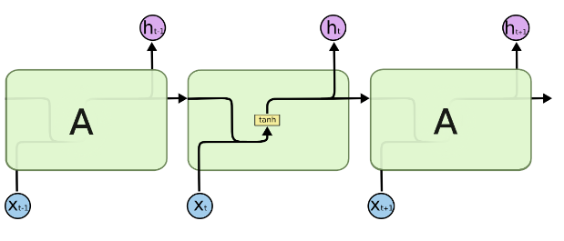
RNN Data flow
The output of current time step becomes the input for the following time step
This is referred as Recurrent
Model examines the current input and the prior ones.

Slide 5
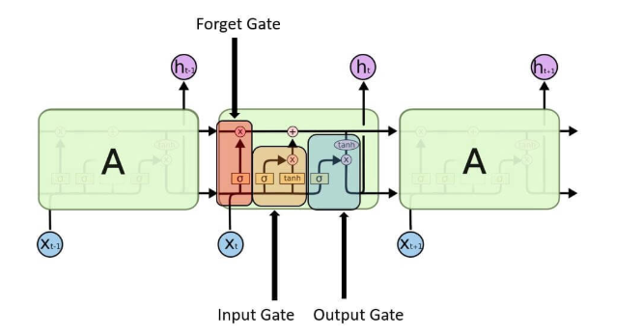
Structure of LSTM
LSTM is made up of four layers and numerous memory block known as cells in a chain structure.
The LSTM unit consist of a cell, a forget gate, an input gate and an output gate.
The flow of information is controlled by three gates and the cell remembers values over arbitrary time intervals.
In this diagram rectangular region labeled A represent the Cell

Slide 6
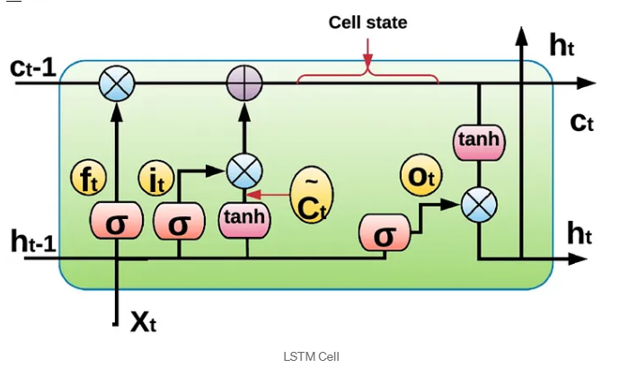
Cell States
The Cell has two states - Cell state and Hidden state
They continuously updated and carry information from previous to current time steps
Cell State : It is the “Long-Term” memory.
Hidden State : It is the “Short-Term” memory.

Slide 7
Use of Gates
The Cell store information and the gates manipulate memory
Input Gate : It determines which input values should be used to change the memory.
Forget Gate : It finds the details that should be removed from the cell state.
Output Gate : Determines the hidden state based on update cell state.
Filter the information that LSTM will output based on update cell state.

Slide 8
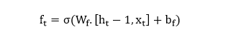
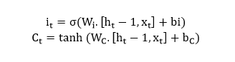
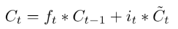
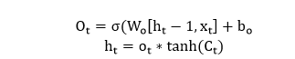
Formulation of Gate
Forget Gate :
Input Gate :
Cell State:
Output Gate:
Hidden State :
Forget Gate :
Input Gate :
Cell State:
Output Gate:
Hidden State :

Slide 9

Process
Data Collection Stock price from NSE ( National Stock Exchange – India )
Select quantity of data input to Neural Network
Data Preprocessing
Split data for training and test data.
Train Model
Run Model for Prediction
Run Model for Forecasting
Visualize the Prediction and Forecasting.
Compare Prediction and Forecasting with ground truth
Perform EDA

Slide 10
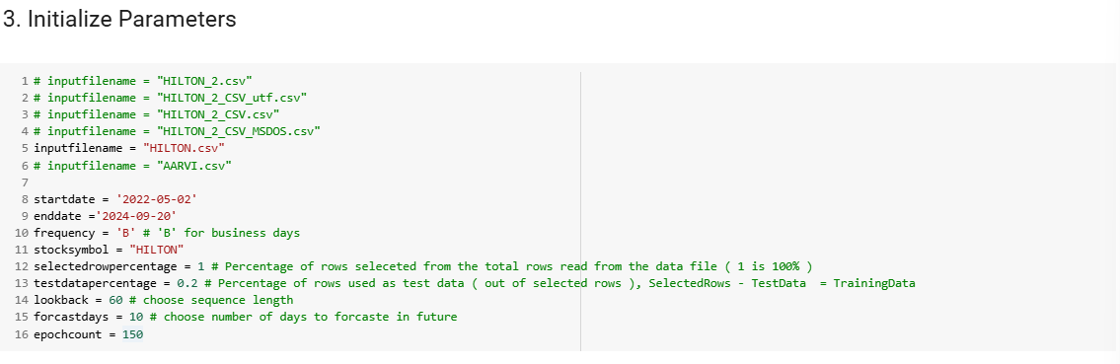
Initialize Parameters for the Project

Slide 11
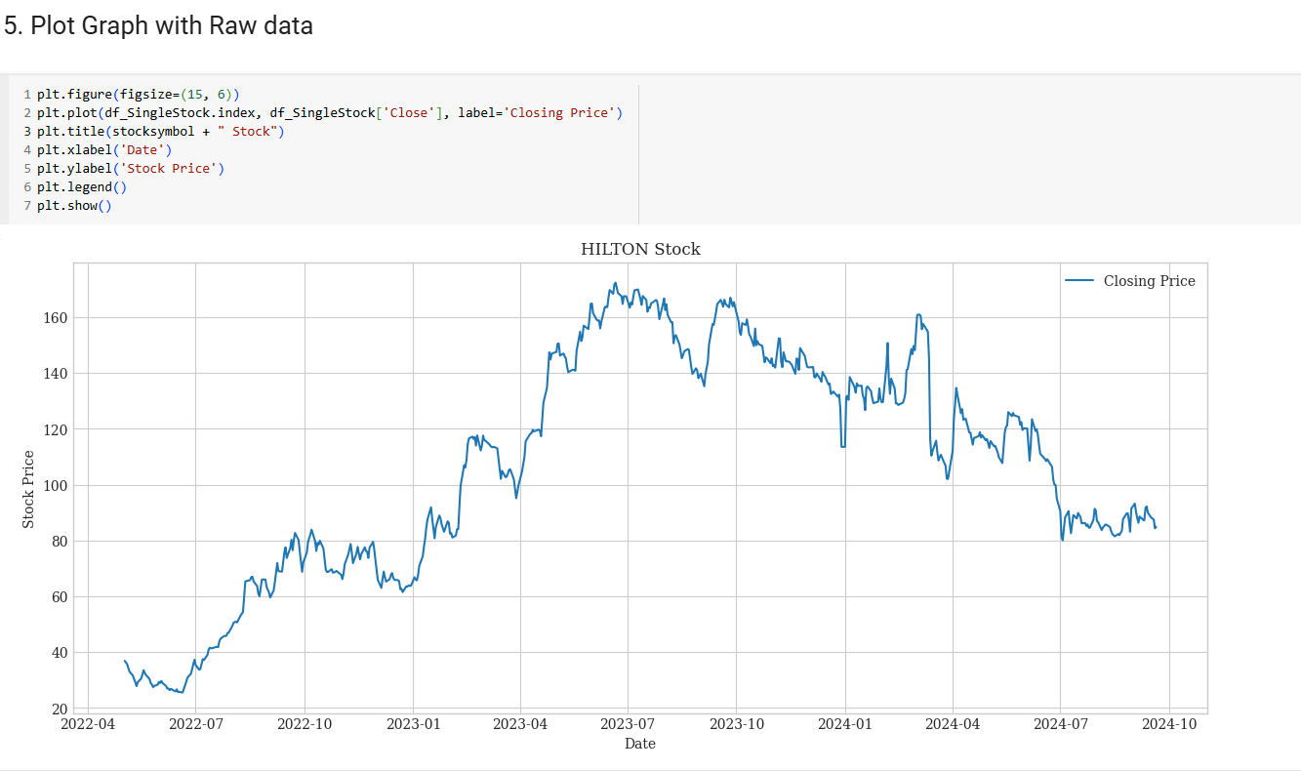
Perform EDA

Slide 12
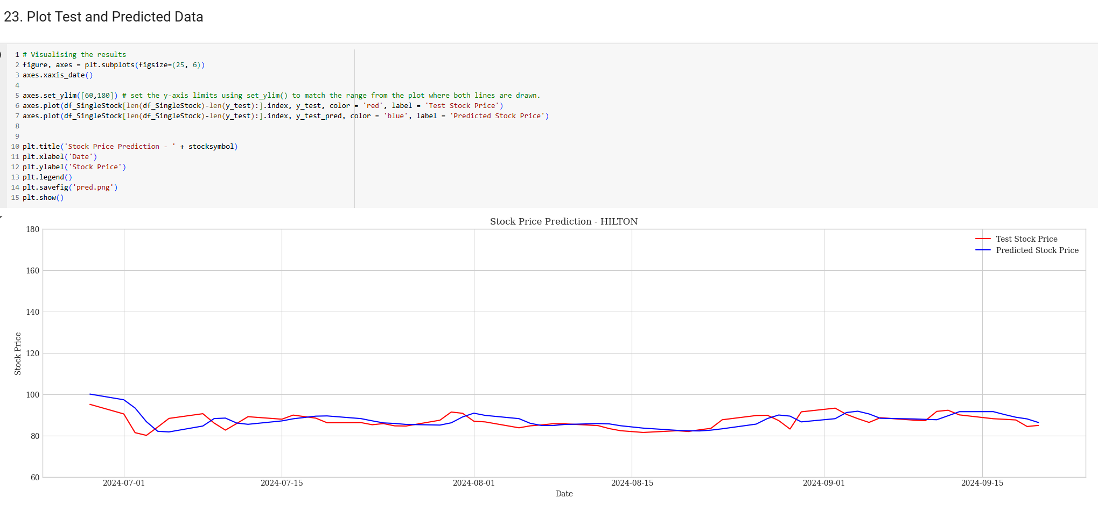
Prediction - Visualization D. Plot Test and Predicted Data

Slide 13
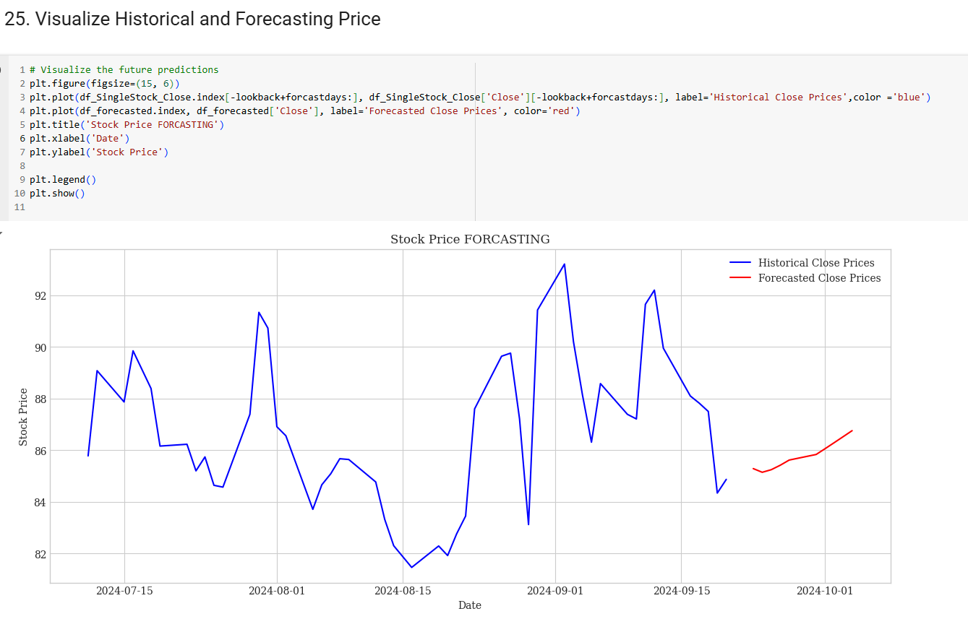
Forecasting - Visualization A. Plot Historical and Forecasting price

Slide 14
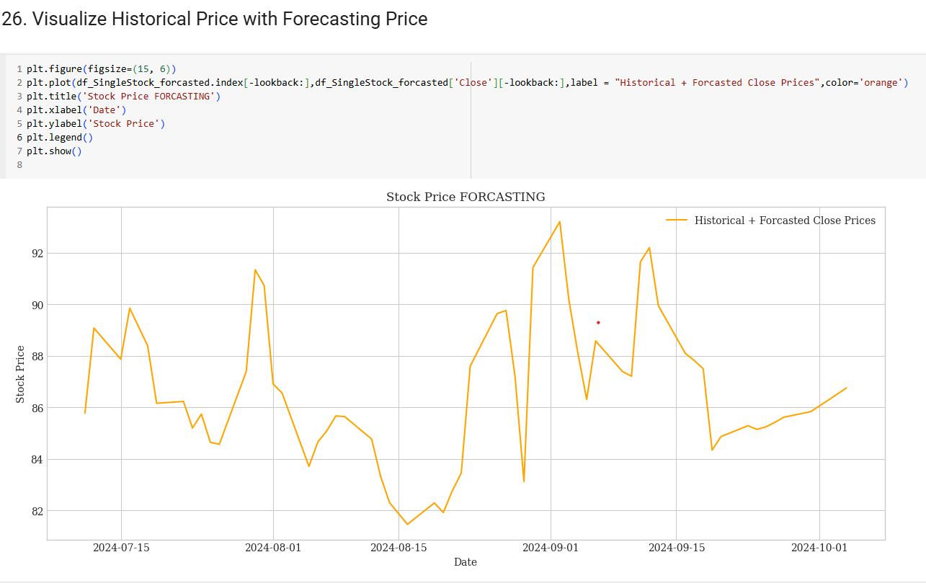
Forecasting - Visualization B. Plot Historical Price with Forecasting Price as a single line

Slide 15
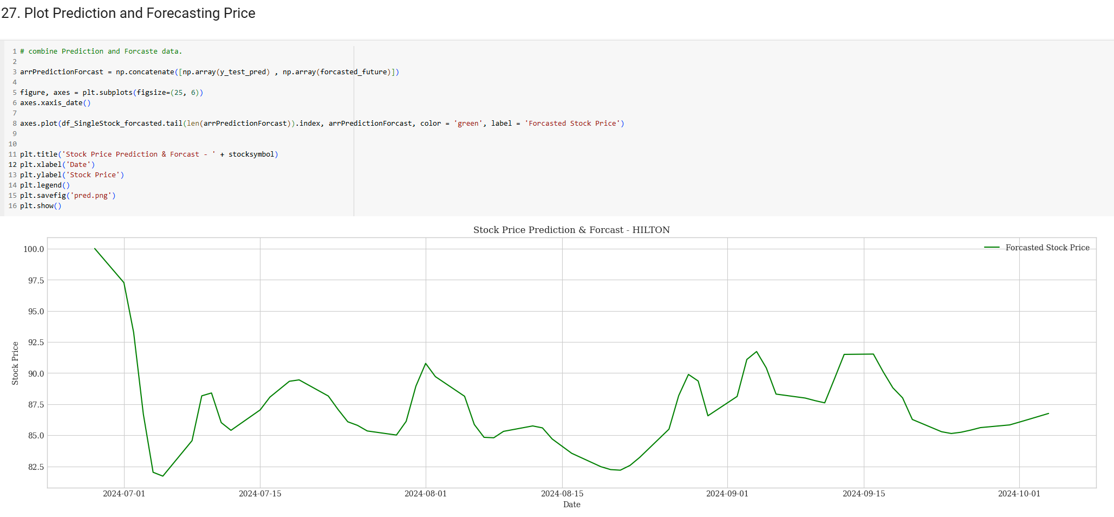
Forecasting - Visualization C. Plot Prediction Price and Forecasting Price as a single line

Slide 16
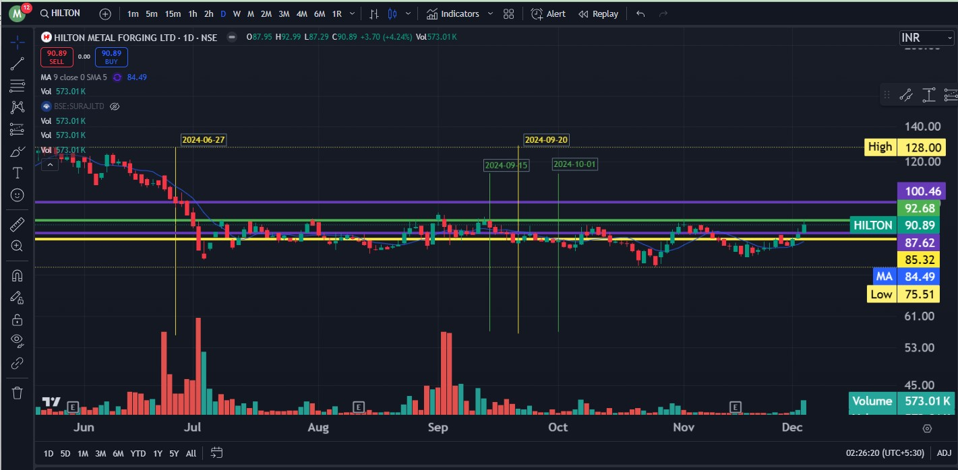
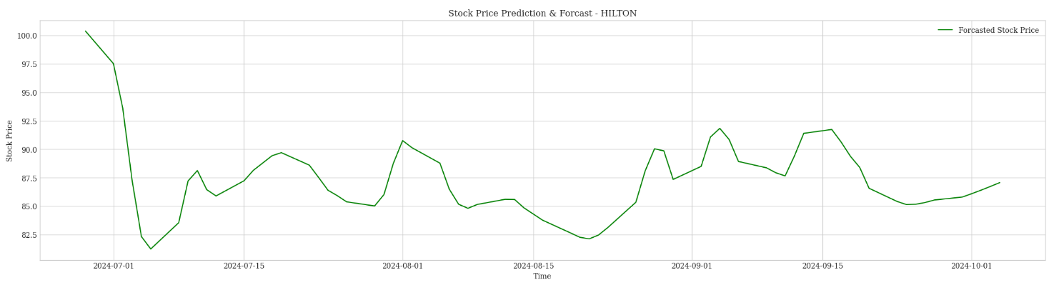
Forecasting - Visualization C. Plot Prediction Price and Forecasting Price as a single line
Forecasting
Forecasting

Slide 17
Forecasting - Visualization C. Plot Prediction Price and Forecasting Price as a single line
Forecasting
Forecasting

Slide 18

Conclusion Stock Price in isolation can contributing substantially to the prediction and forecasting of price trend, in short period of 2 weeks.

